Slide 1

Python Programming
Practice Sheets
Generic - Spring 2022 – V. 1

Slide 2


Practice 1:
1- Develop a Python program to print the multiplications table from 1x1 to 10x10. Consider a nice tabular format, possibly with separators.
2- Write a Python program that reads 3 numbers from the keyboard and checks if they can be sides of a rectangular triangle or not. (a** == b**+c**) ??
Your program should show the result by printing appropriate messages.
<number>

Slide 3
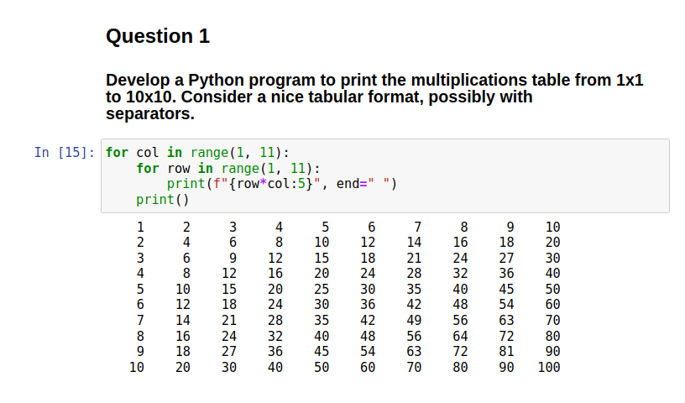
PRACTICE 1:

Slide 4
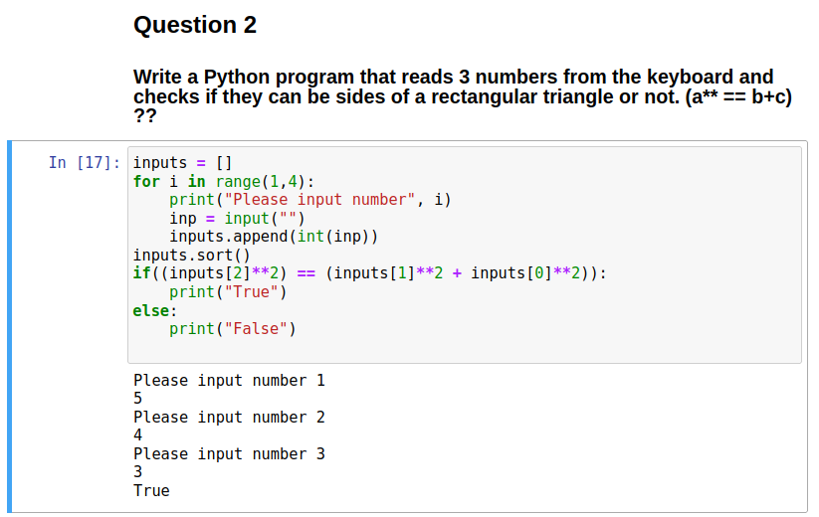
PRACTICE 1:

Slide 5
Practice 2: DATA Files
Open and read the contents of the resale.csv data file.
Find and print the most expensive flat
Find and print the cheapest flat
Find and print the average and variance of the flat’s prices.
How many flats are in the WOODLANDS?
<number>

Slide 6
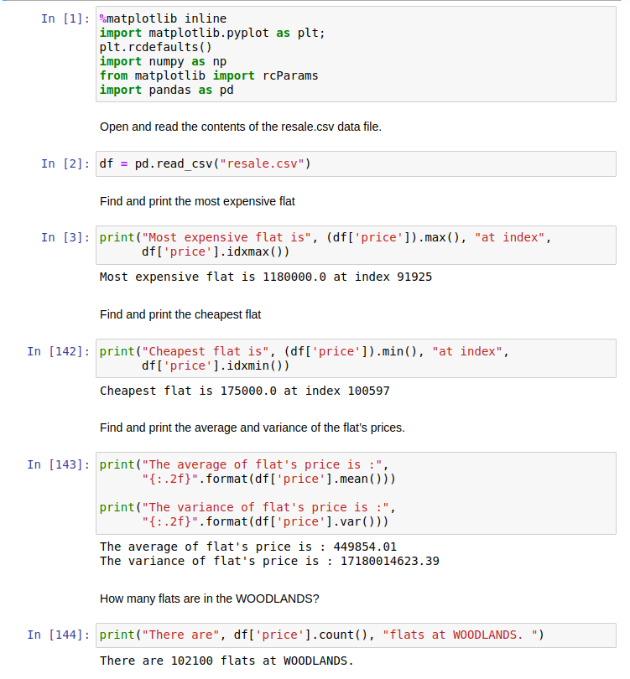
Practice 2: DATA Files
<number>

Slide 7
Practice 3: Visualization
Open and read the contents of the resale.csv data file.
Separate WOODLANDS flats.
Depict the line chart of WOODLANDS flat’s prices.
Depict the scatter plot of WOODLANDS flat’s prices.

Slide 8
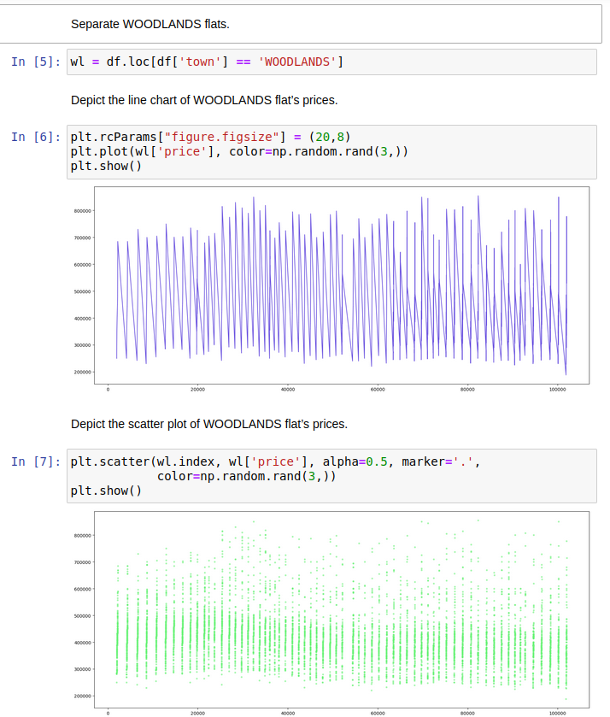
Practice 3: Visualization
<number>
Notes:
<number>

Slide 9
Mini Project 1: Logistic Regression
Open 2.15-Mini-Project Logistic Regression notebook.
Complete and run it
Report the results
<number>

Slide 10
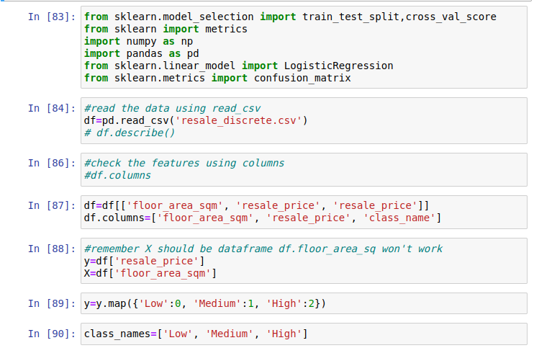
Mini Project 1: Logistic Regression
<number>

Slide 11
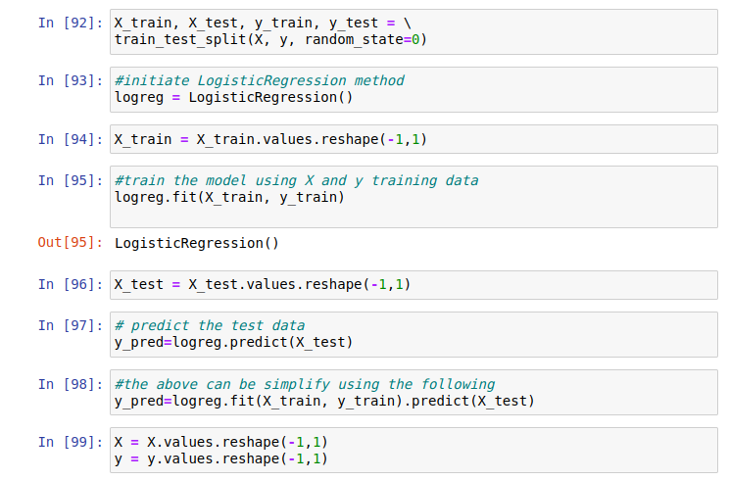
Mini Project 1: Logistic Regression
<number>

Slide 12
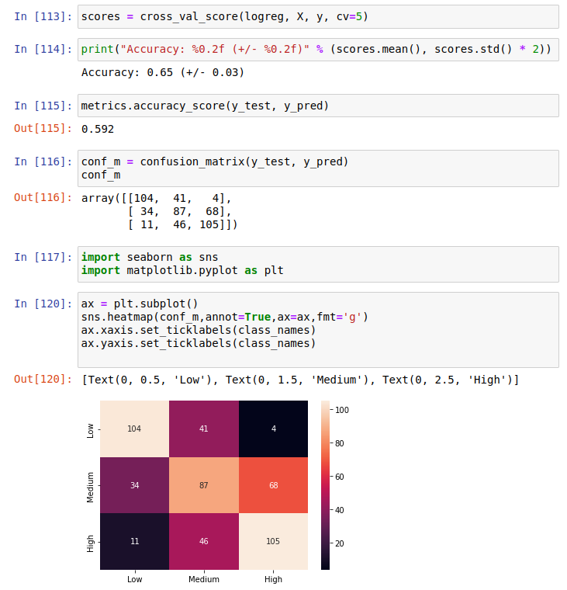
Mini Project 1: Logistic Regression
<number>

Slide 13
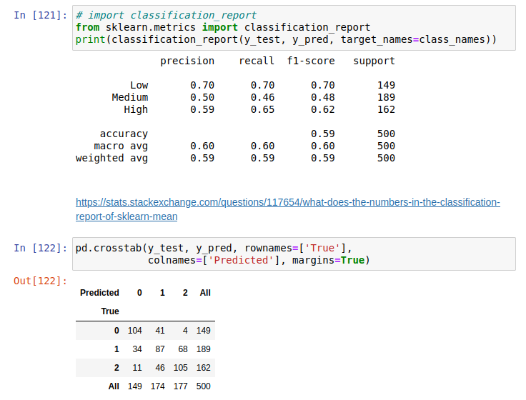
Mini Project 1: Logistic Regression
<number>

Slide 14
Mini Project 2: Regression
Open 2.17-Mini-Project Regression notebook
Complete and run it
Report the results
<number>

Slide 15
Mini Project 2: Regression
<number>

Slide 16
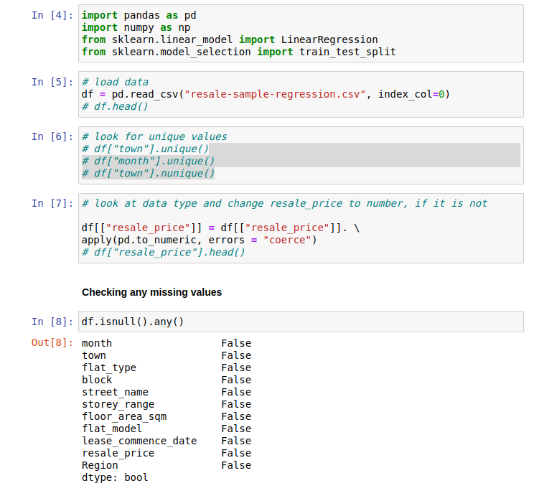
Mini Project 2: Regression
<number>

Slide 17
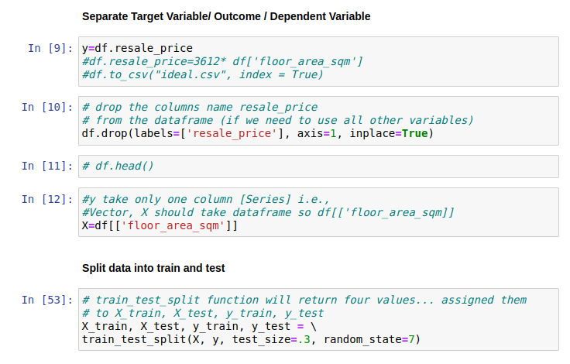
Mini Project 2: Regression
<number>

Slide 18
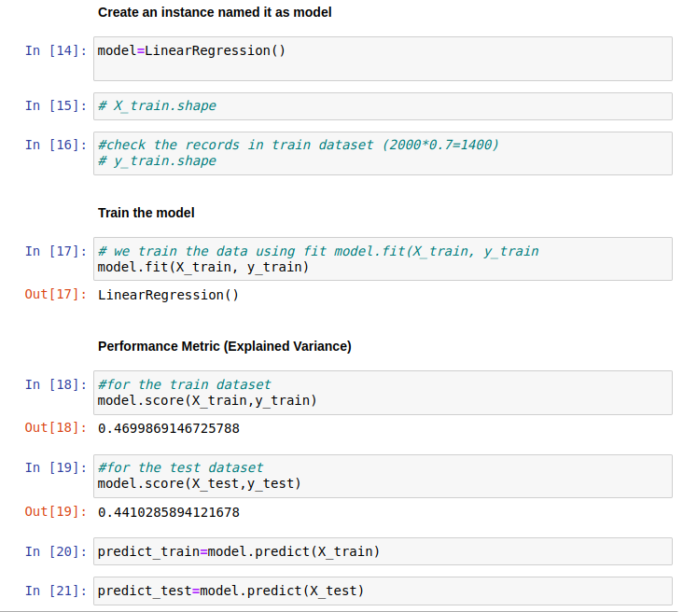
Mini Project 2: Regression
<number>

Slide 19
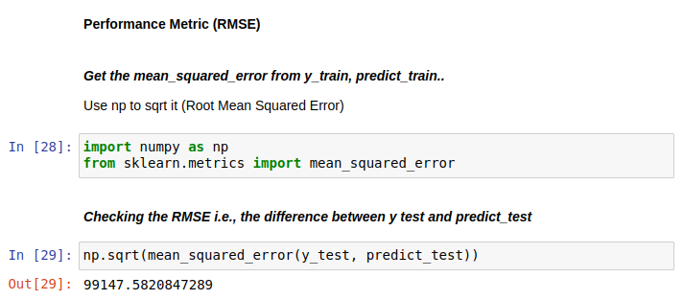
Mini Project 2: Regression
<number>

Slide 20
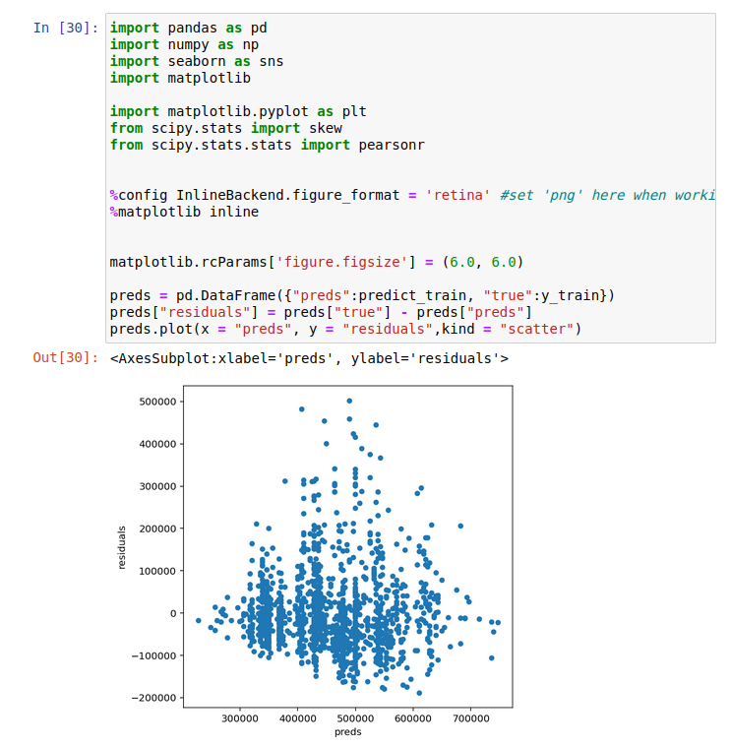
Mini Project 2: Regression
<number>

Slide 21
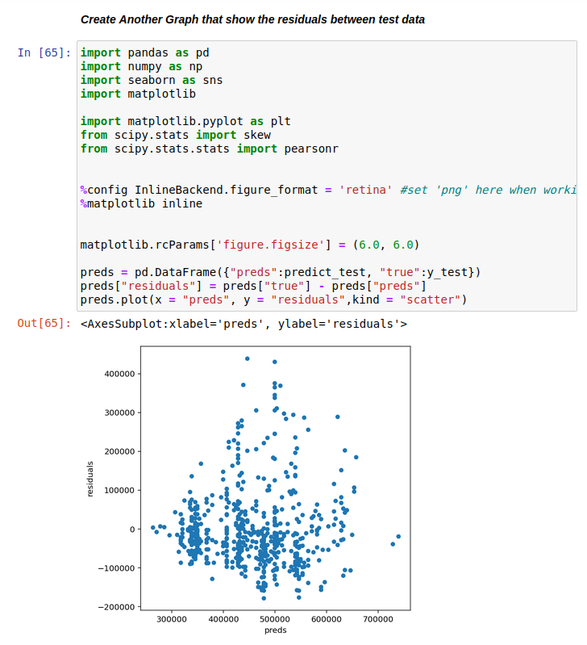
Mini Project 2: Regression
<number>

Slide 22
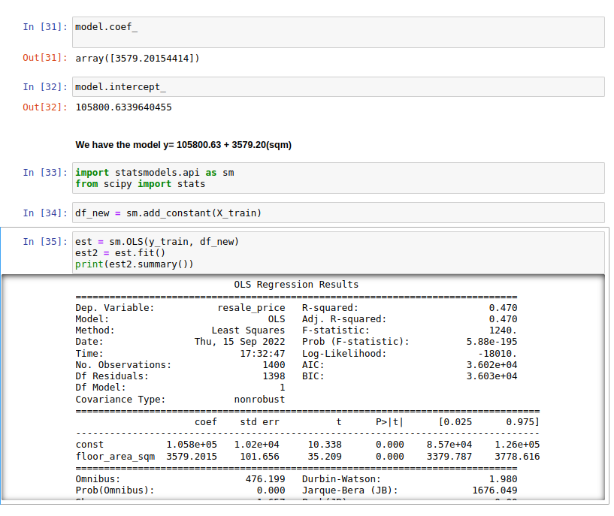
Mini Project 2: Regression
<number>

Slide 23
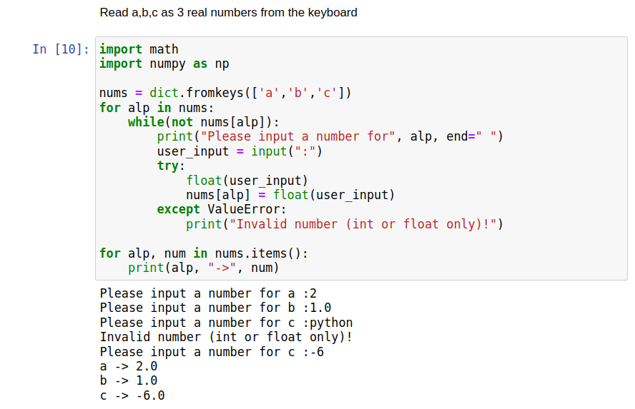
Final Practice: Solve 2nd order equation ax^2+bx+c=0
<number>

Slide 24
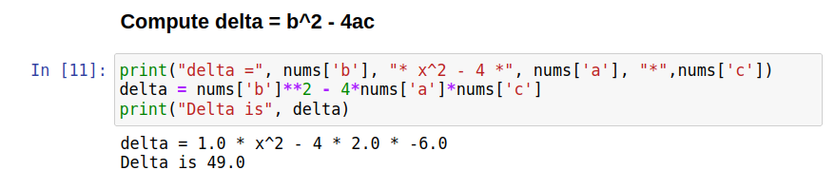
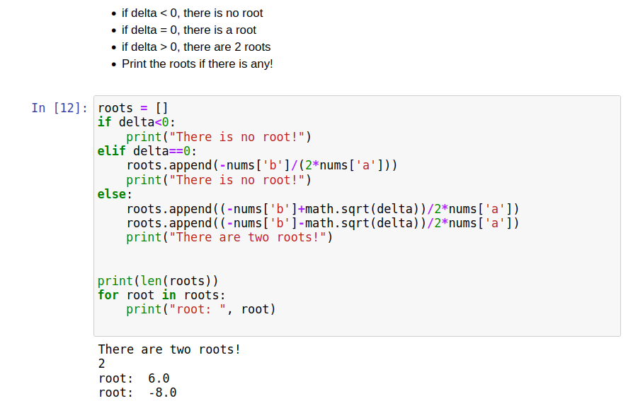
Final Practice: Solve 2nd order equation ax^2+bx+c=0
<number>

Slide 25
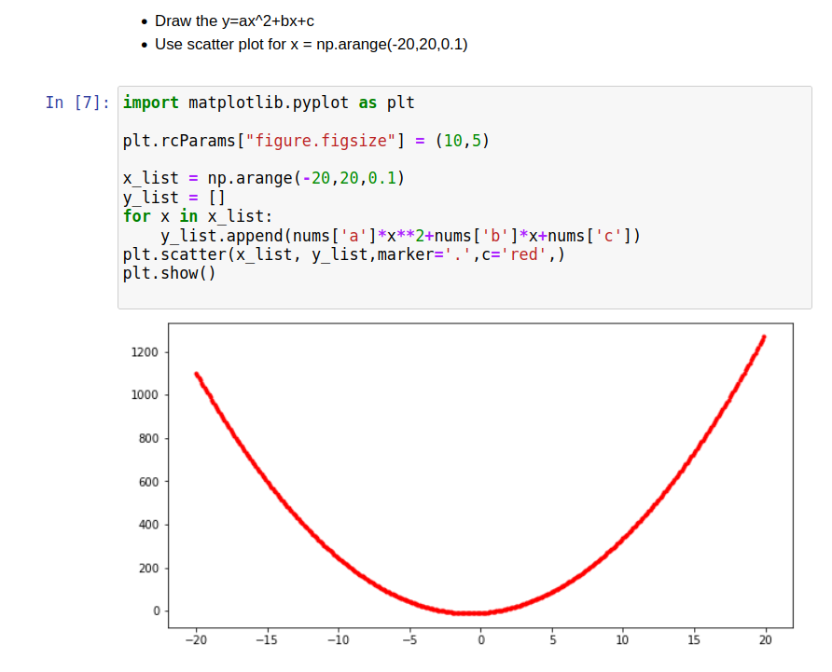
Final Practice: Solve 2nd order equation ax^2+bx+c=0
<number>

Slide 26

This is The End …
<number>

